Slide 1
MySQL Quick Start
Final exam SQL topics presentation
Zixiao

Slide 2
First step!
Create, Use, and Drop DB, Creates tables, Create sample records

Slide 3
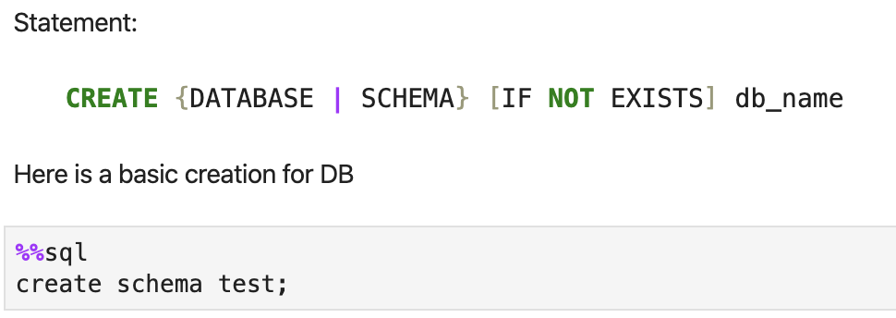
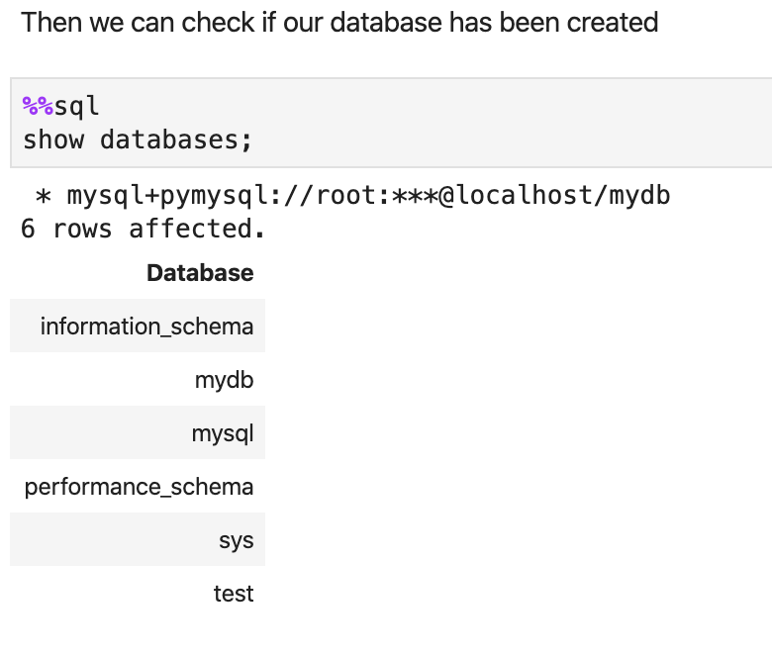
About database...
If you want to use MySQL, the first step is to create a database that belongs to you!

Slide 4
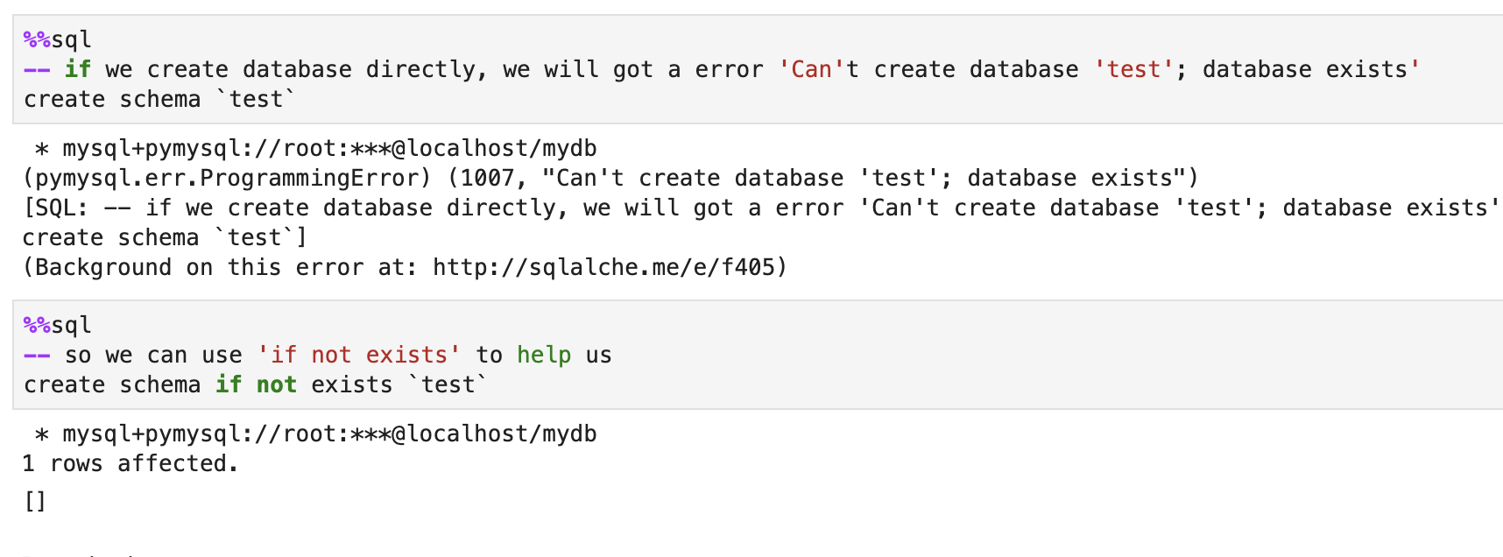
About database...
If you don’t know if the database is exist

Slide 5
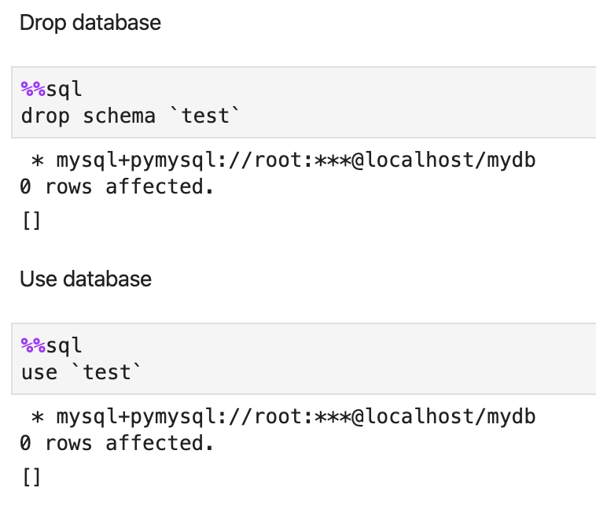
About database...
Here is how you can drop or use a database/schema

Slide 6
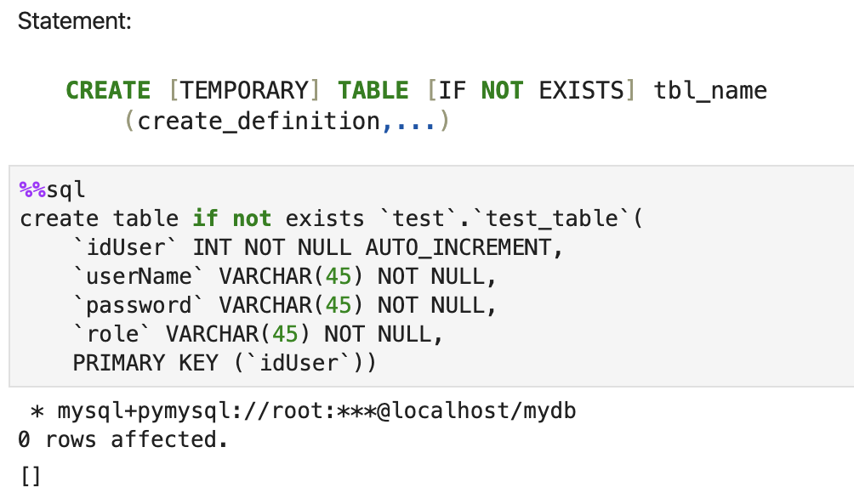
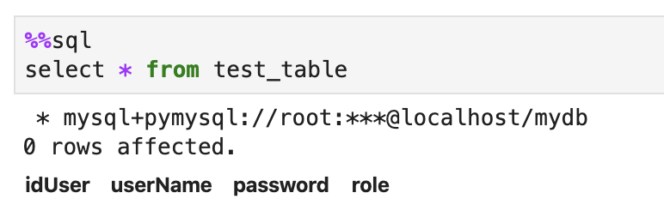
How to create tables
In order to record something, first you need to create some tables

Slide 7
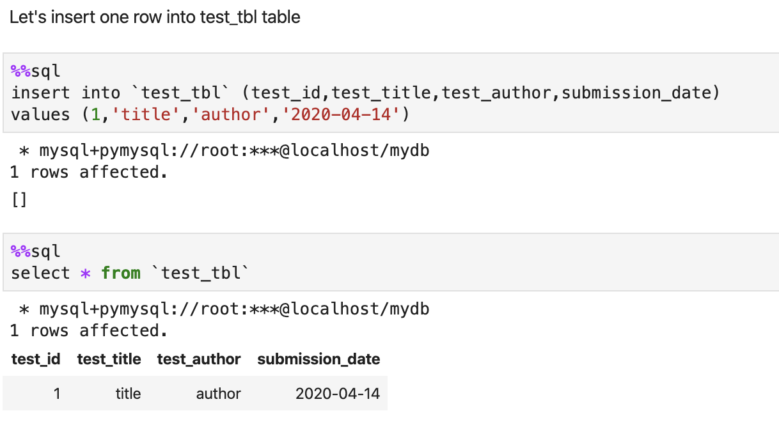
How to record something
You can insert record into table

Slide 8
Second step!
Use DB, create tables with table options (NULL, Key, etc.), data types, insert, index and set

Slide 9
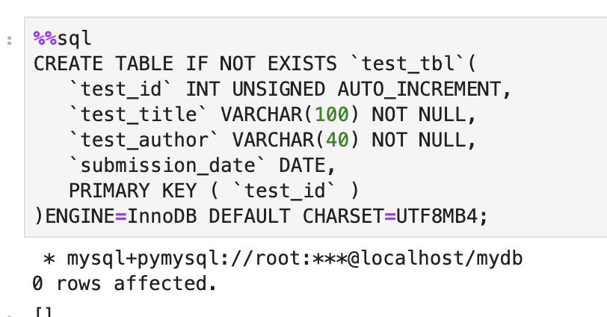
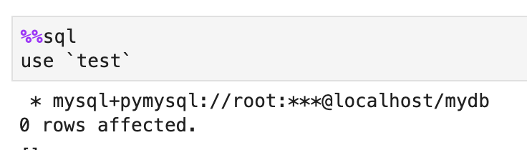
Use Database and Create table
Let’s go through again
Use database
Create tables with table options (NULL, Key, etc.), data types

Slide 10
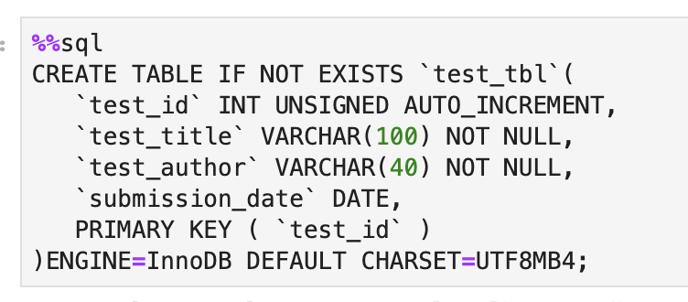
While you are creating table
* If you don't want the field to be NULL, you can set the field's attribute to NOT NULL. If you enter the field's data as NULL when operating the database, you will get an error.
* AUTO_INCREMENT defines the column as a self-increasing attribute, which is generally used for the primary key, and the value will automatically increase by 1.
* The PRIMARY KEY keyword is used to define the column as the primary key. You can use multiple columns to define the primary key, separated by commas.
* ENGINE sets the storage engine, and CHARSET sets the encoding.

Slide 11
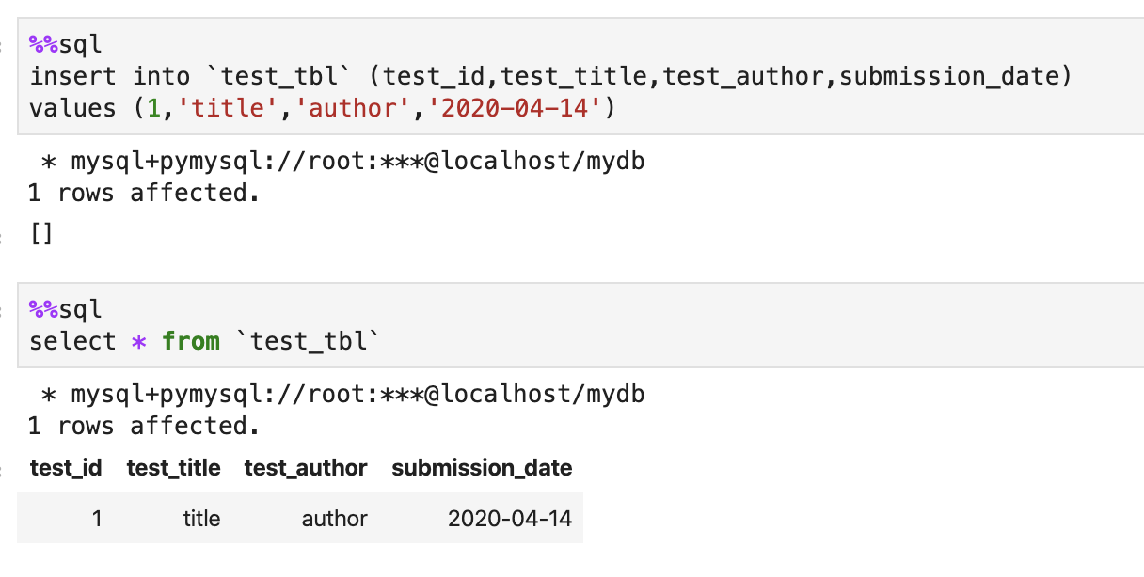
Insert data into table
Let's insert one row into test_tbl table

Slide 12
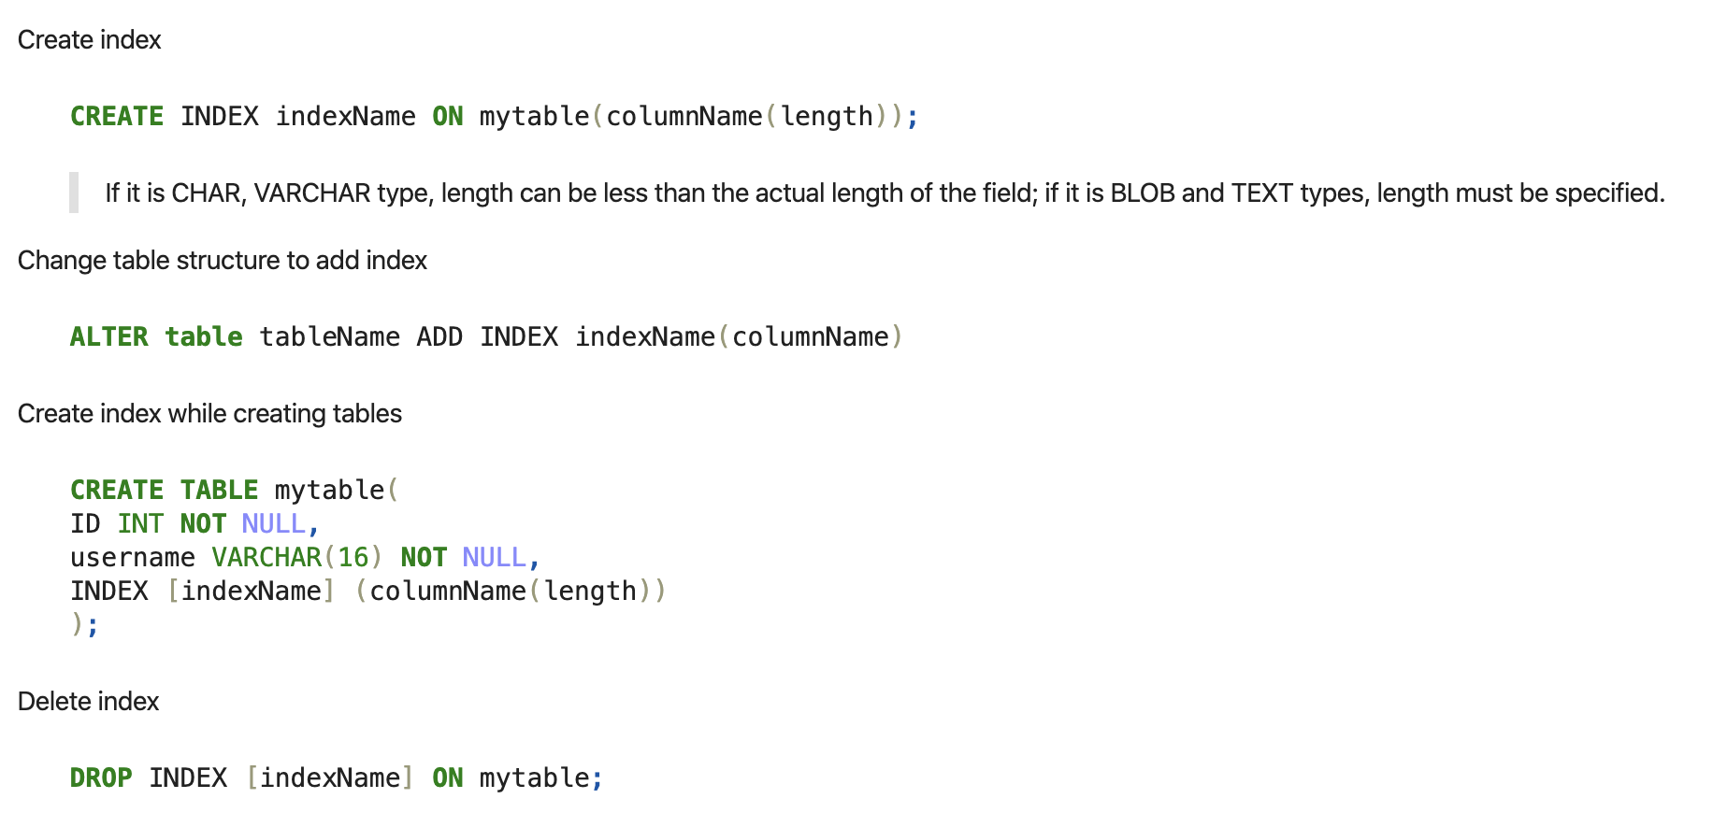
What about index?

Slide 13
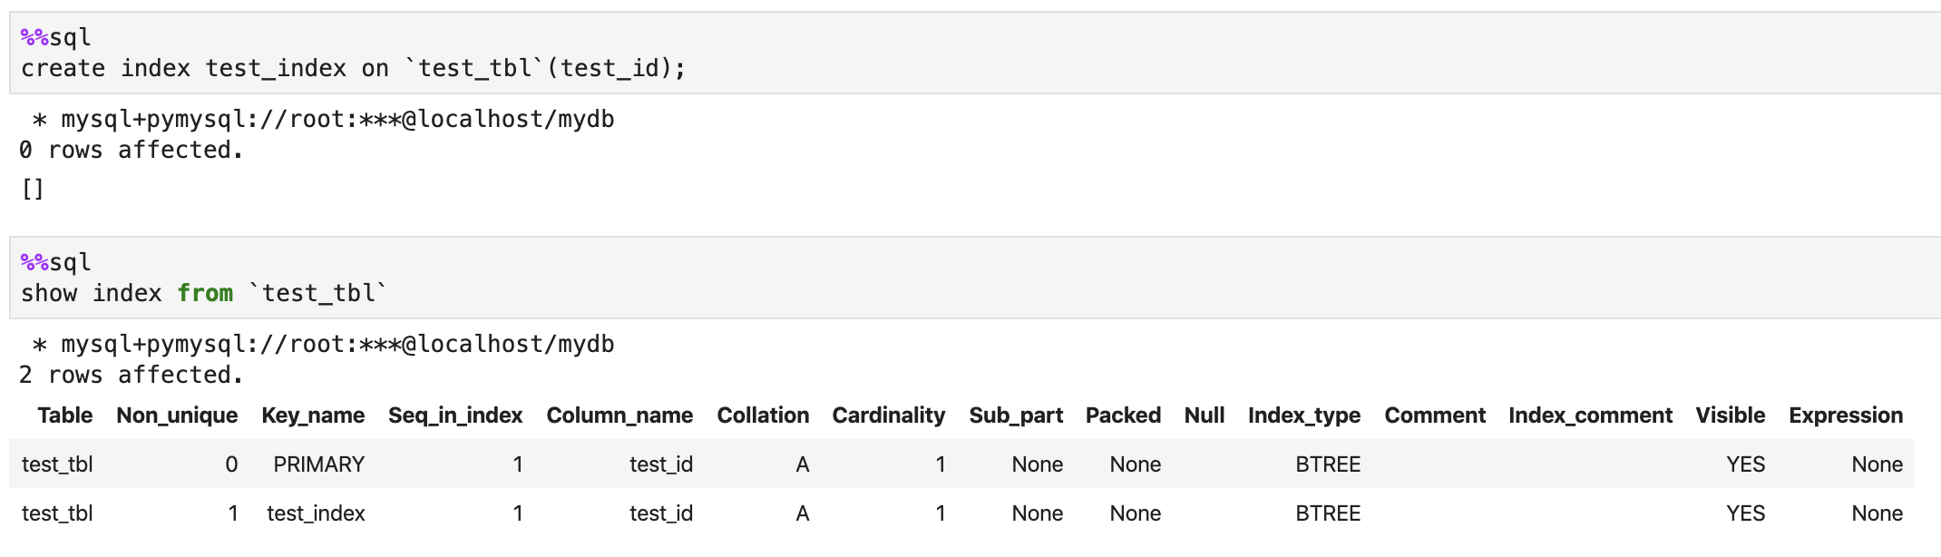
Create index

Slide 14
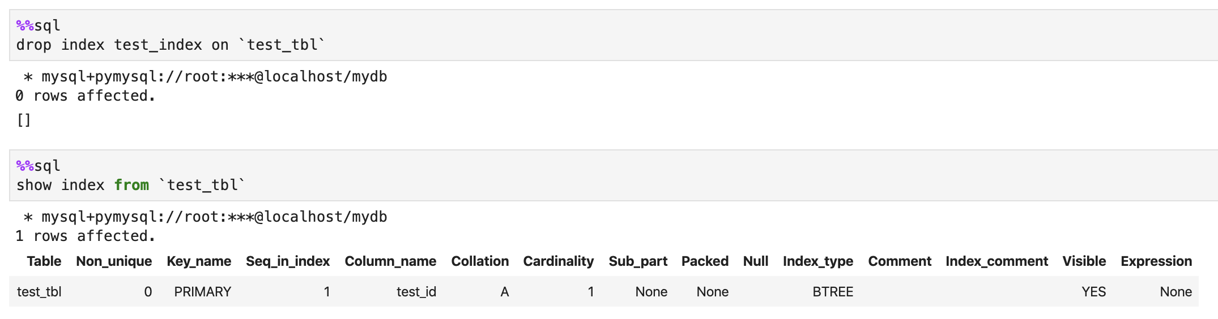
Drop index

Slide 15
What is set?
A SET is a string object that can have zero or more values, each of which must be chosen from a list of permitted values specified when the table is created.
SET column values that consist of multiple set members are specified with members separated by commas (,). A consequence of this is that SET member values should not themselves contain commas.

Slide 16
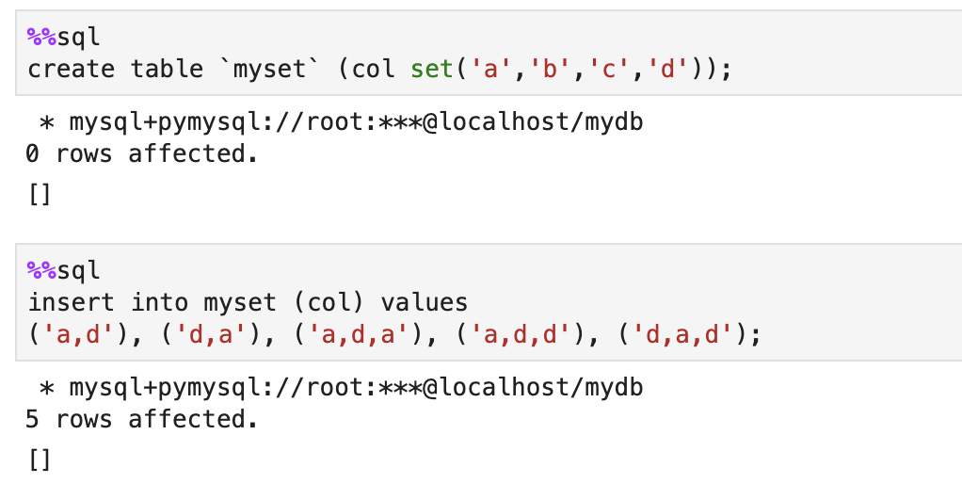
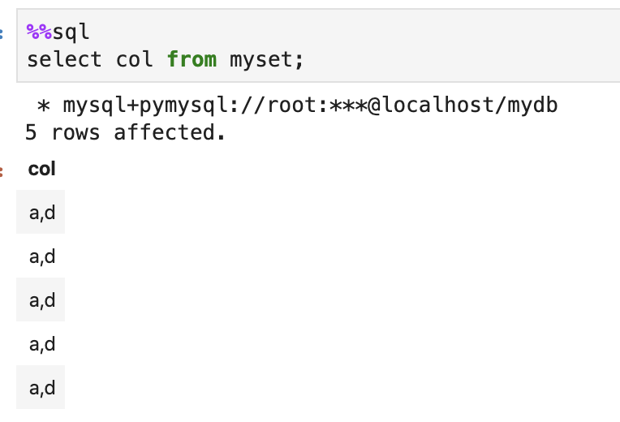
Set

Slide 17
Third step!
Select – From – Where – Group By – Having - Order By – Limit

Slide 18
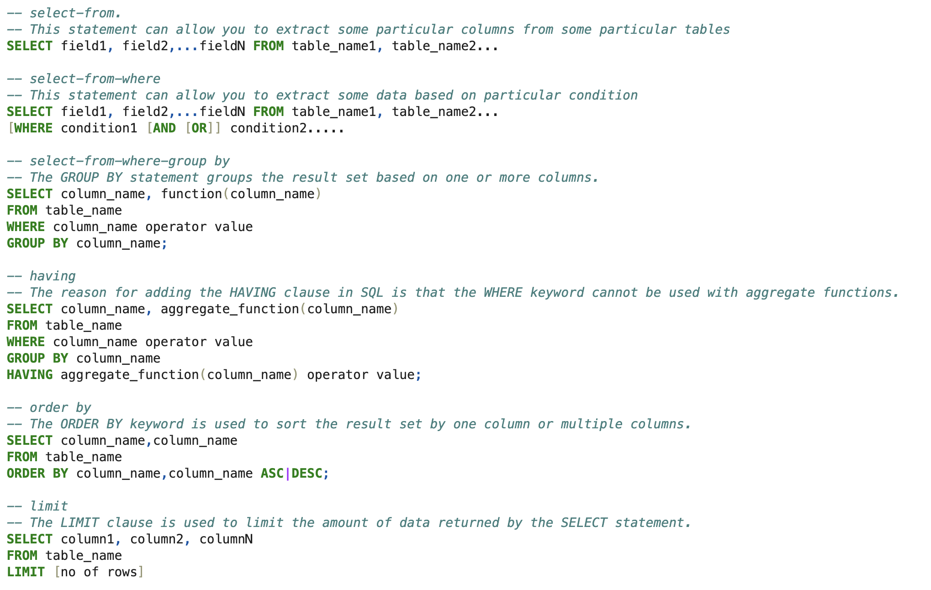
How to check my data?

Slide 19
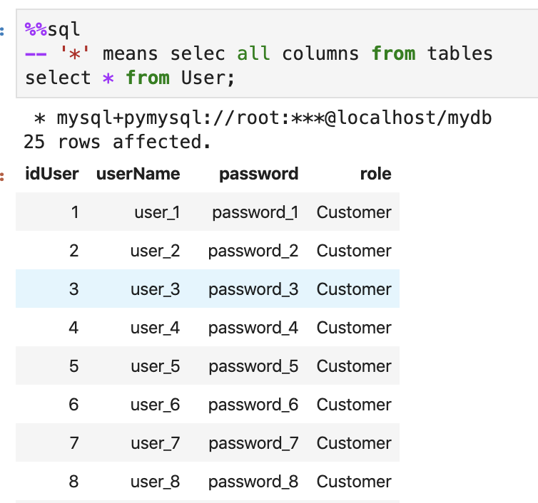
select-from

Slide 20
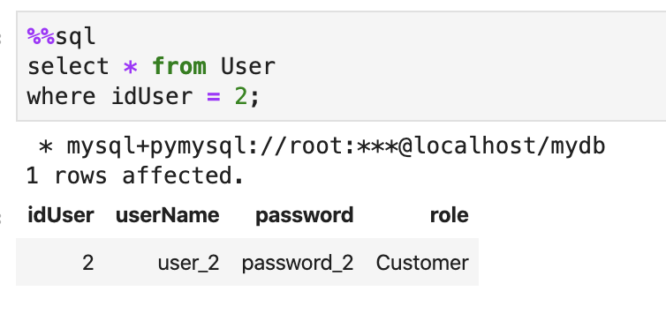
select-from-where

Slide 21
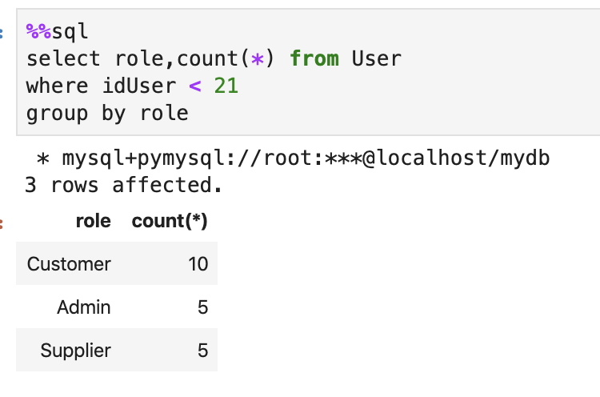
select-from-where-group by

Slide 22
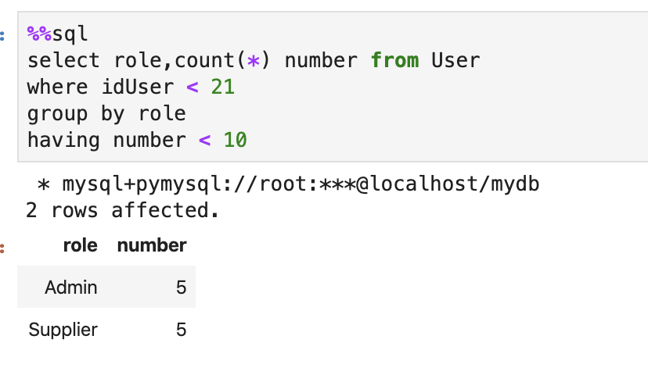
having

Slide 23
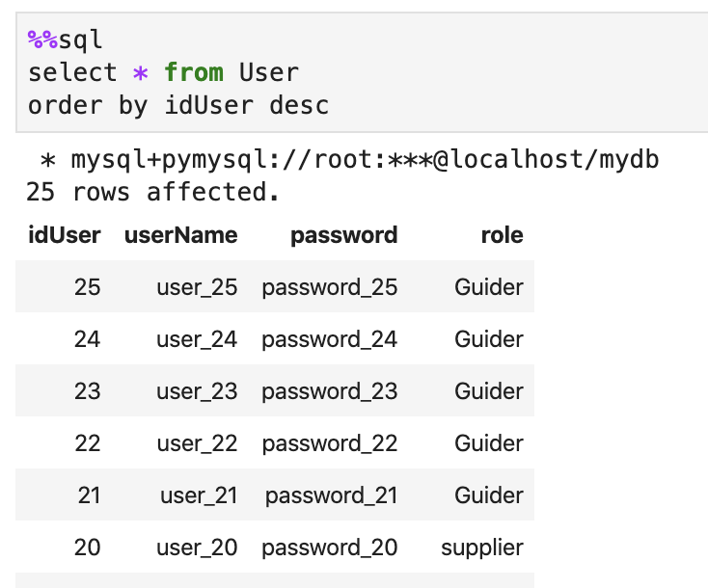
order by

Slide 24
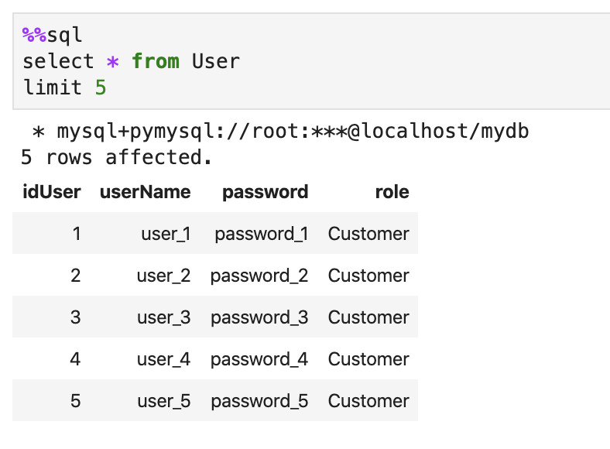
limit

Slide 25
Next step!
Functions in SQL statement

Slide 26
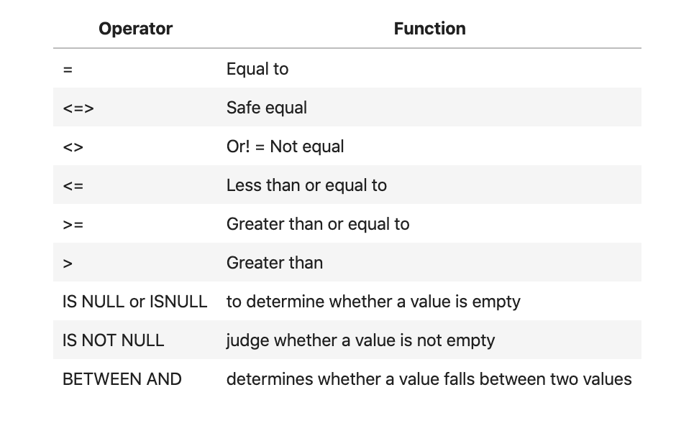
Comparison

Slide 27
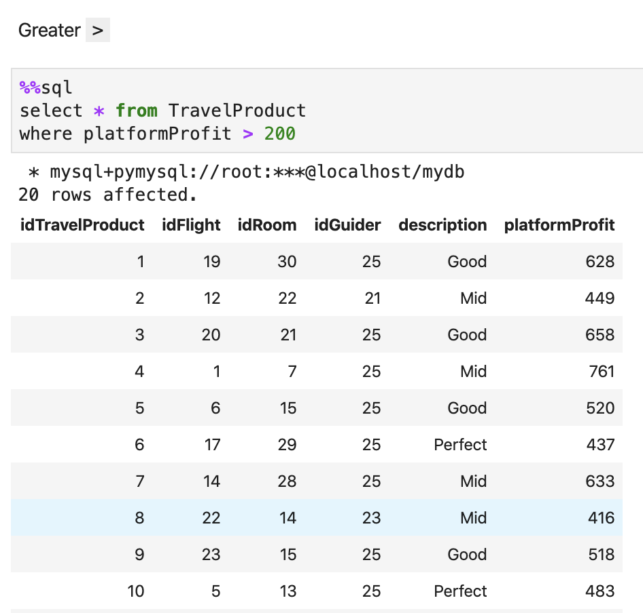
Comparison

Slide 28
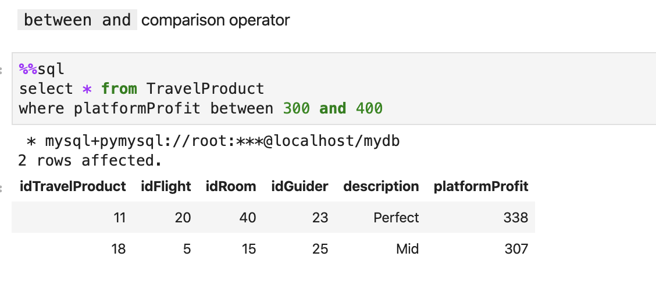
Comparison

Slide 29
Control flow
There are four Control Flow functions in MySQL
CASE operator
IF/ELSE construct
IFNULL
NULLIF

Slide 30
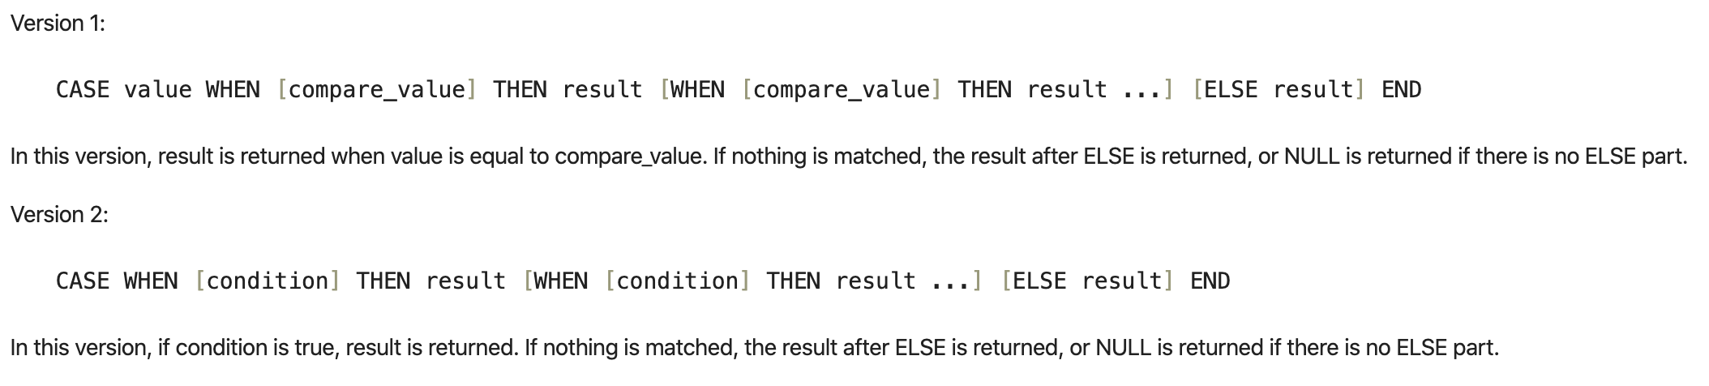
CASE

Slide 31
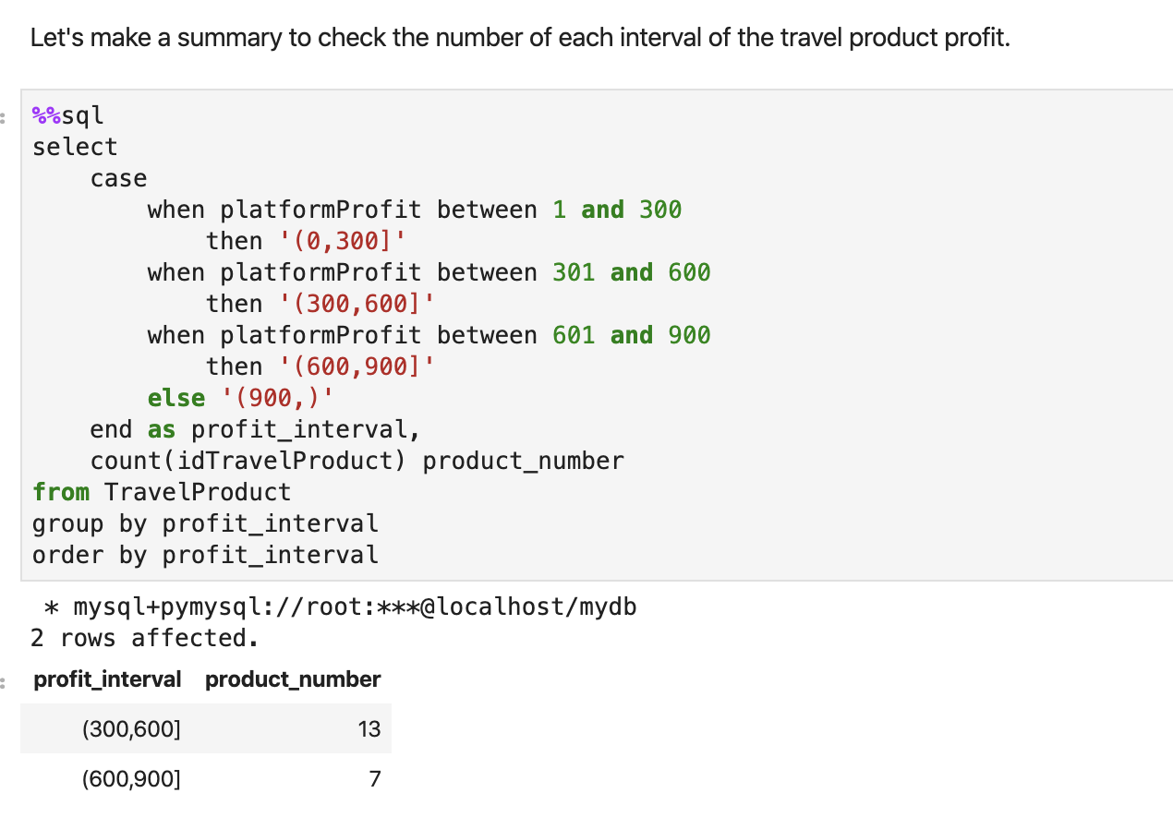
CASE

Slide 32
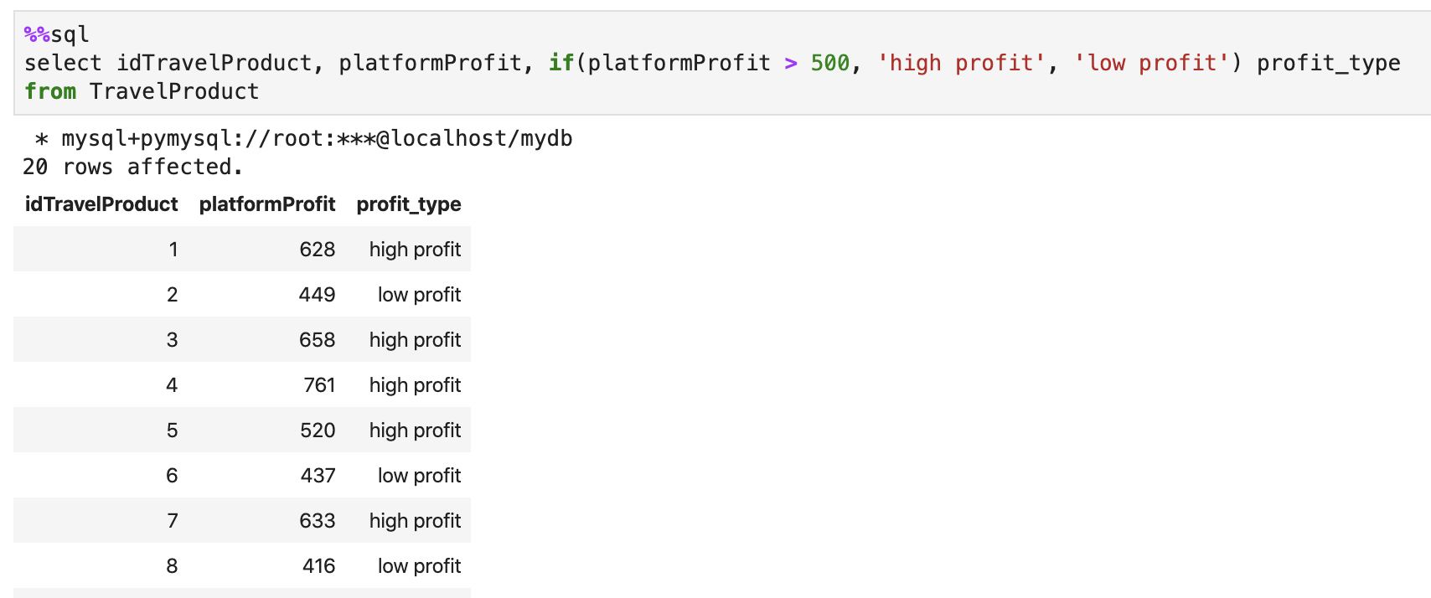
IF/ELSE

Slide 33
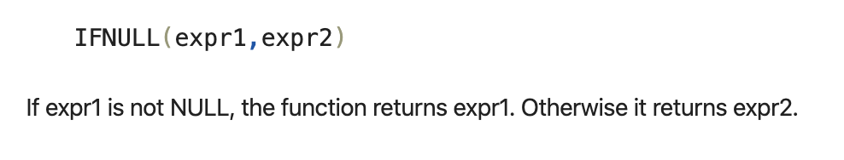
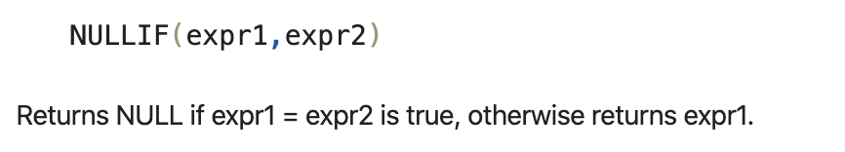
IFNULL & NULLIF

Slide 34
What is CAST?
The CAST function converts any type of value to a value of the specified type

Slide 35
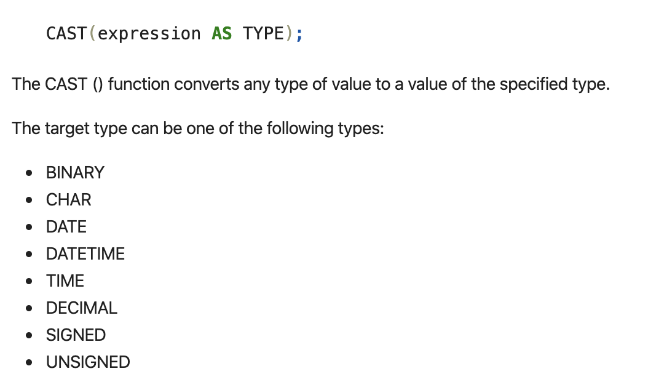
How to use cast

Slide 36
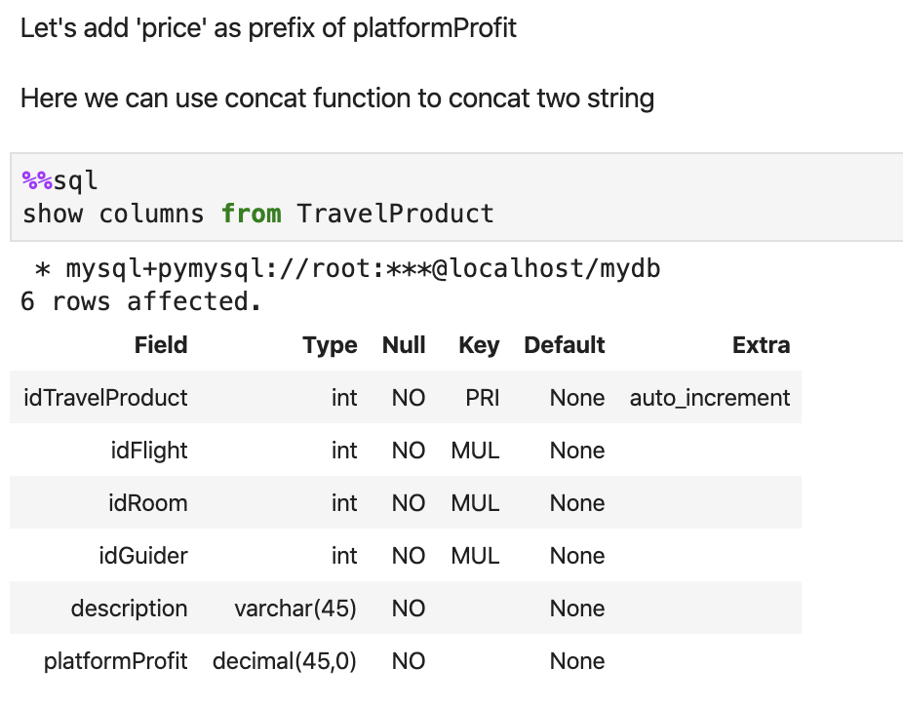
CAST

Slide 37
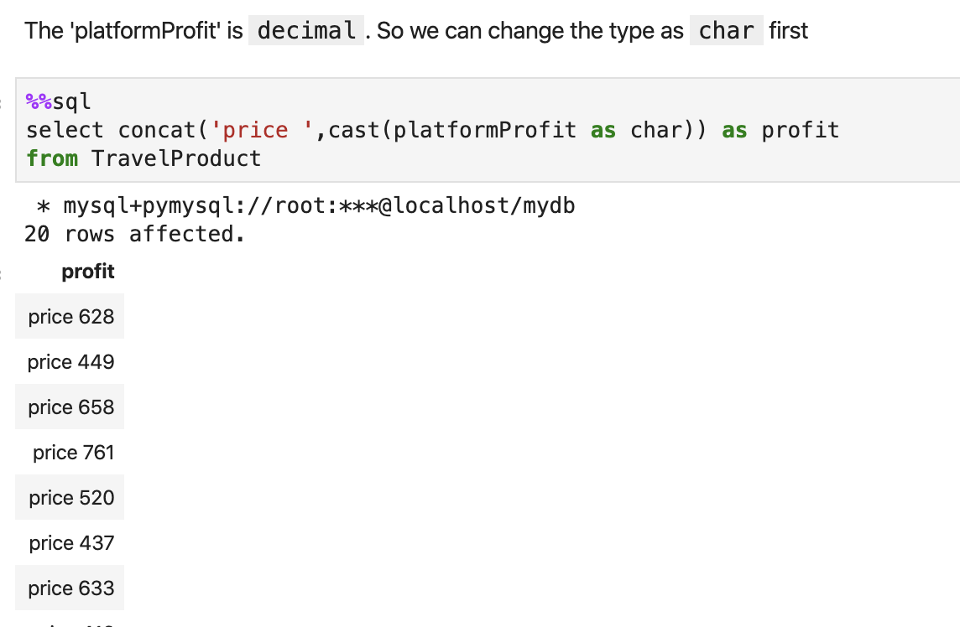
CAST

Slide 38
String in MySQL
How to use string in MySQL

Slide 39
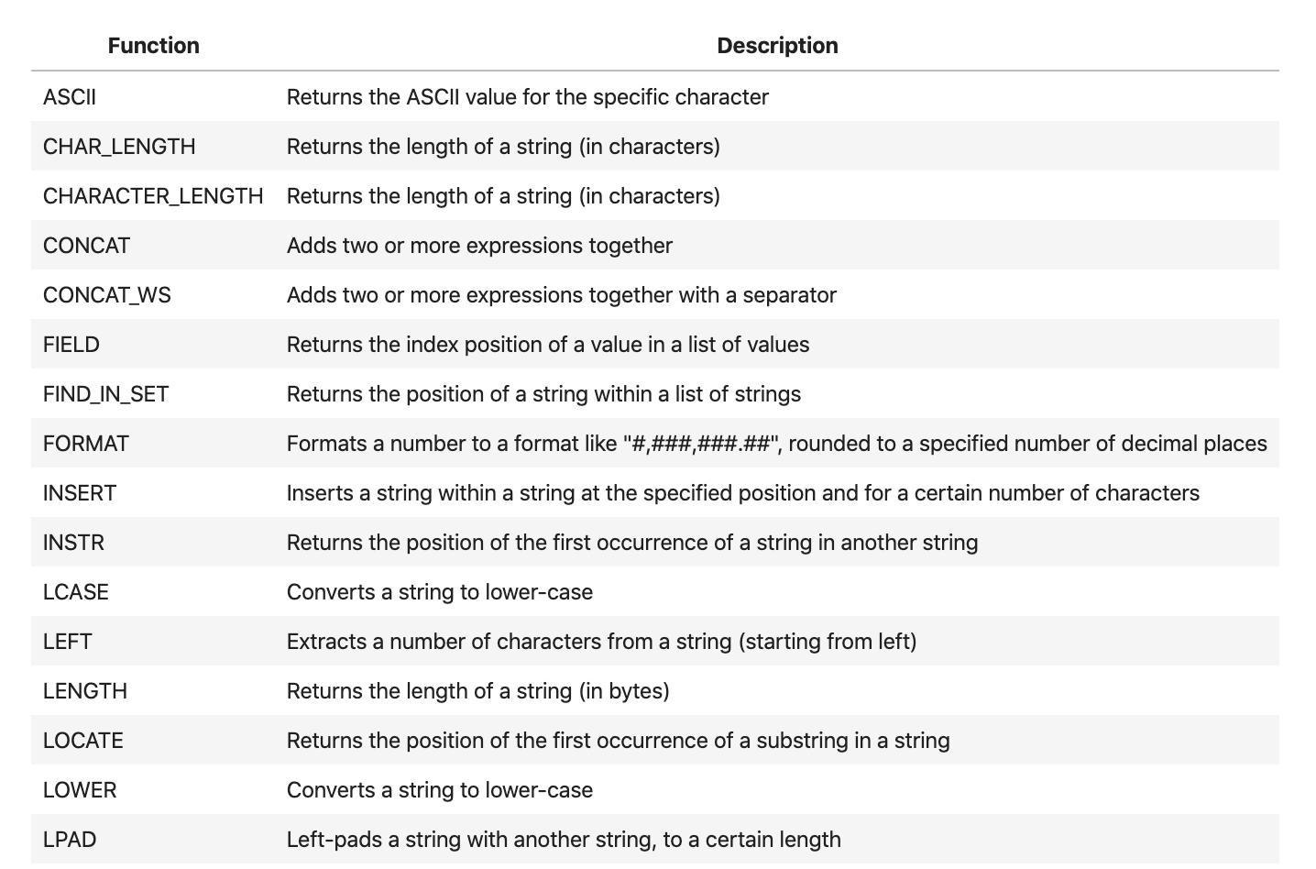
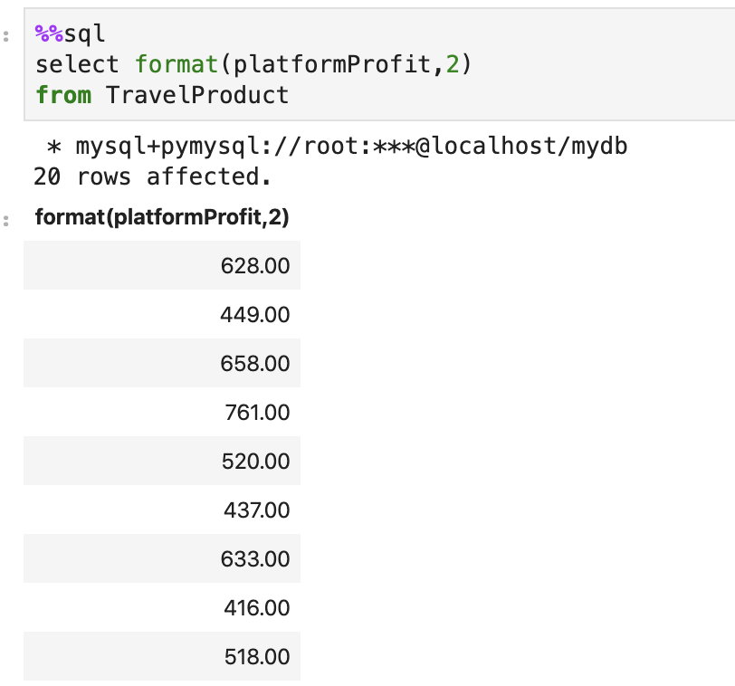
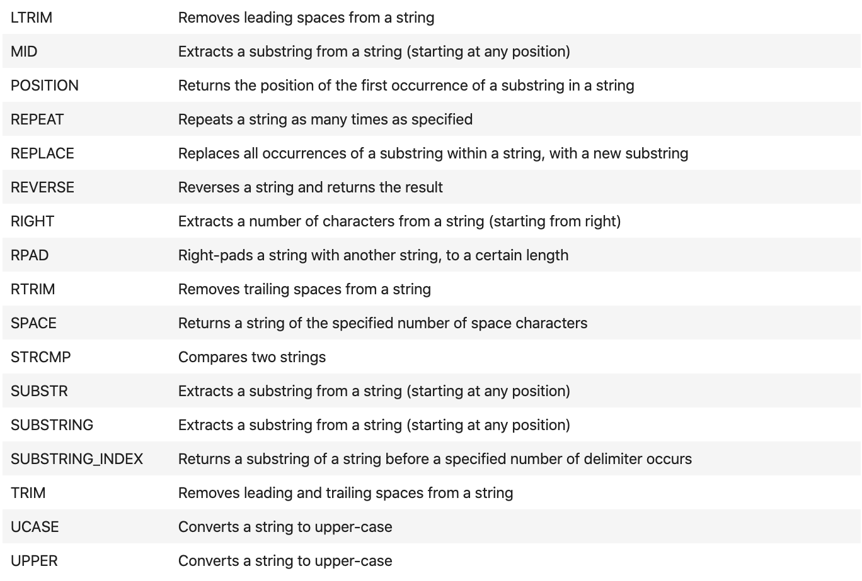
Function to operate String

Slide 40
Numeric in MySQL
How to operate number

Slide 41
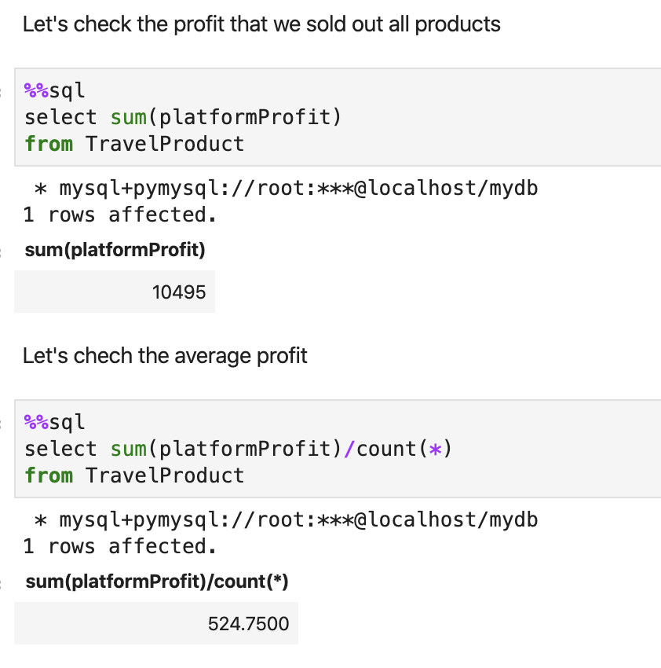
SUM

Slide 42
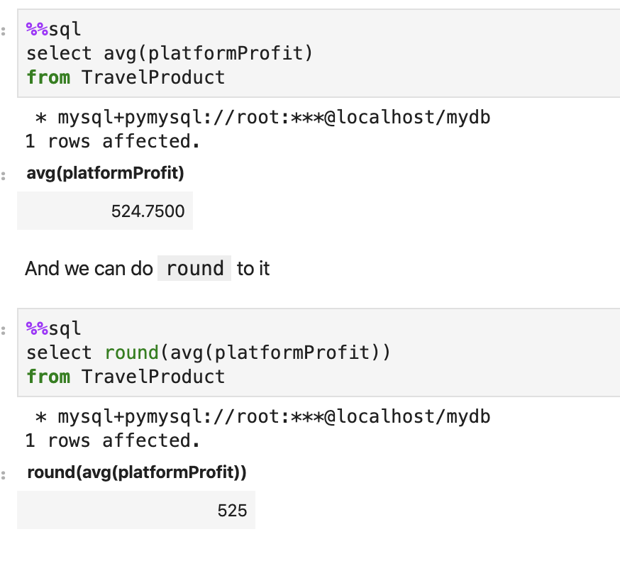
AVG & ROUND

Slide 43
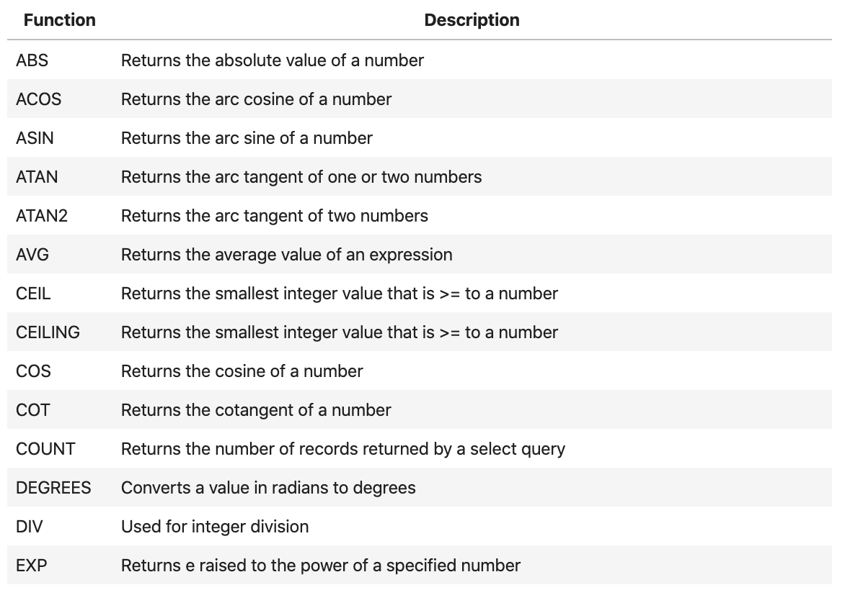
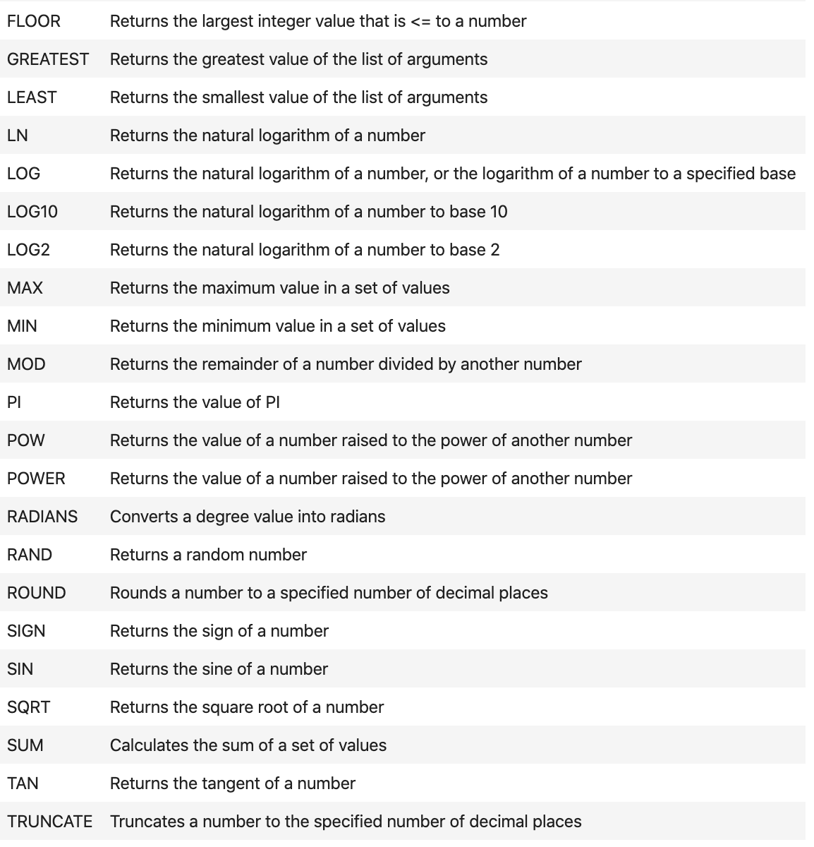
Function to operate number

Slide 44
Date/time manipulation
How to operate time and date

Slide 45
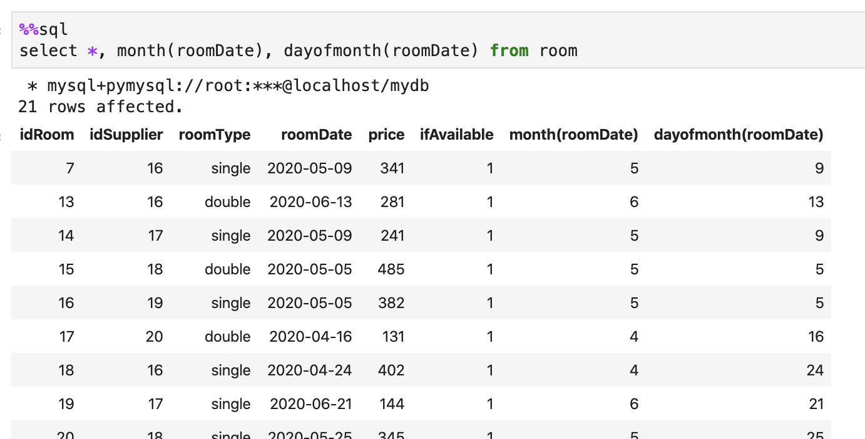
How to know mouth

Slide 46
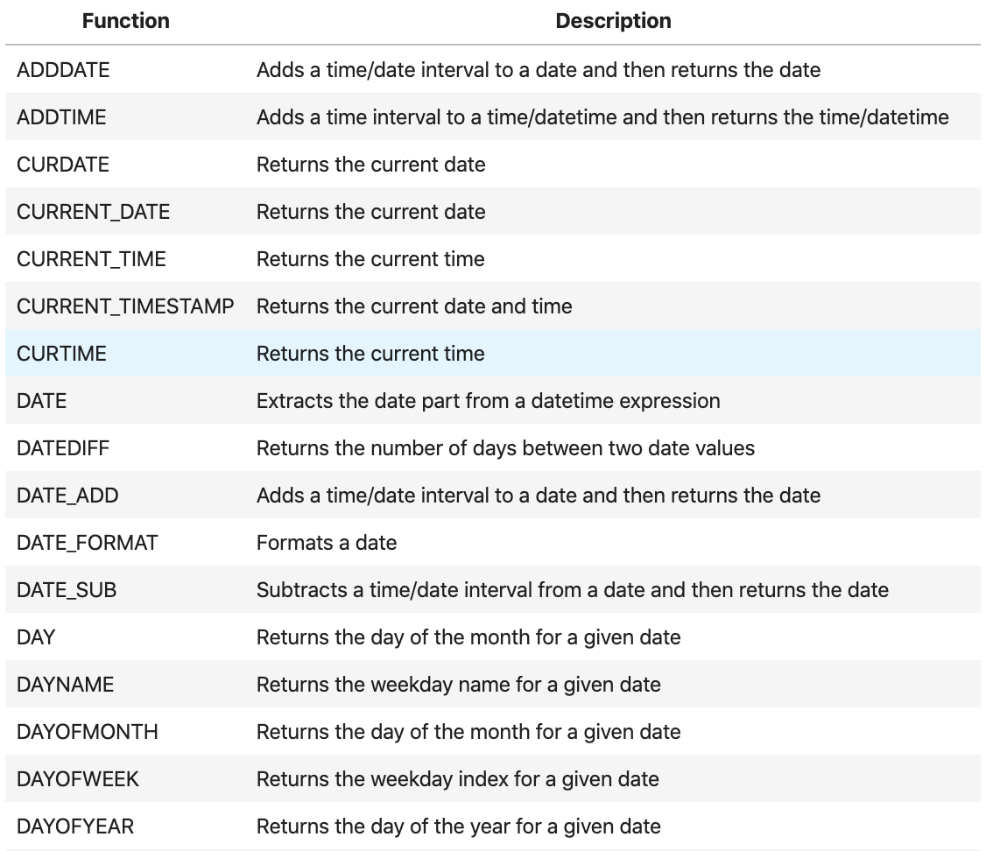
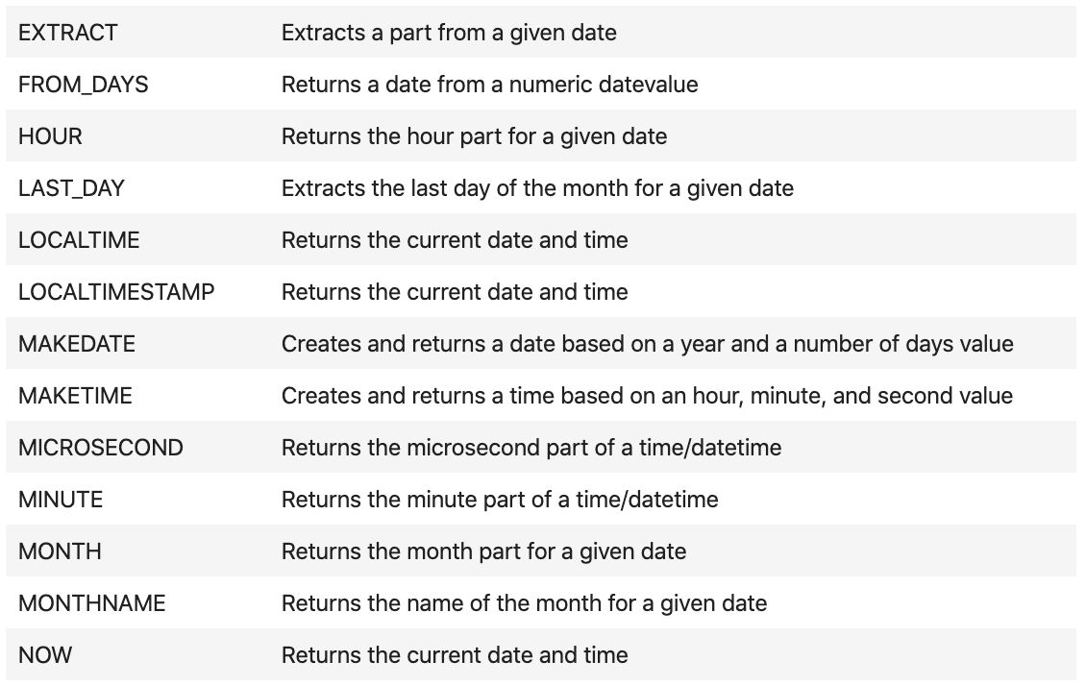
Function that can help you

Slide 47
Calculation
You can calculate something in SQL

Slide 48
Why we need calculation
When data is retrieved from a MySQL database it is not always in the form we need it. For example, we may need to display a customer name and address as a single text string, but in reality the name and address are held in separate tables.

Slide 49
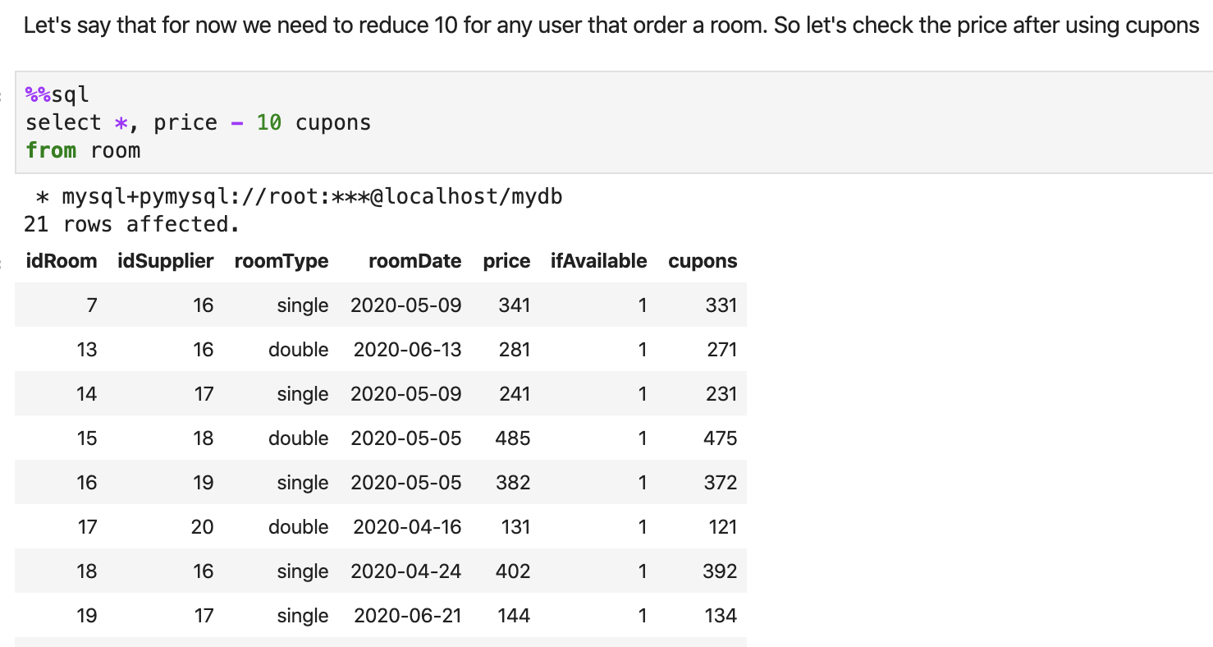
Example

Slide 50
Conversion
How to change data type

Slide 51
Conversion
MySQL Conversion Functions convert a value from one data type to another. Conversions can be conducted between string, date, and numeric type of data.
There are three Conversion Functions in MySQL:
CONVERT
CAST
BINARY

Slide 52
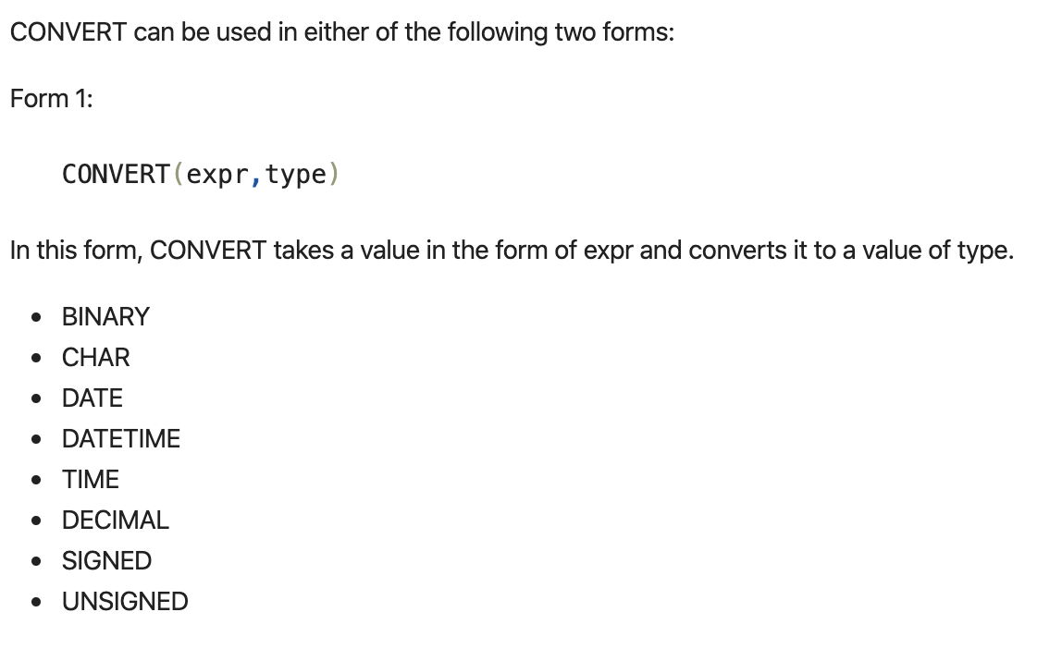

CONVERT

Slide 53
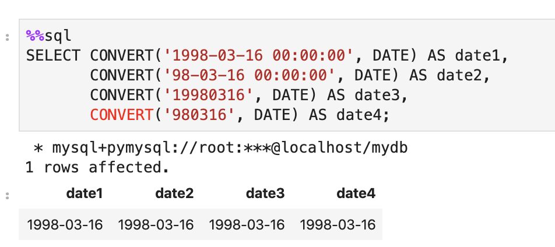
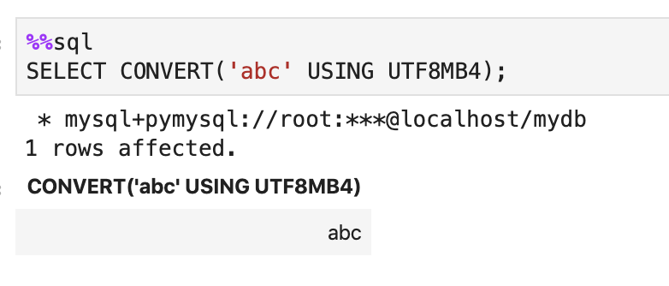
CONVERT

Slide 54
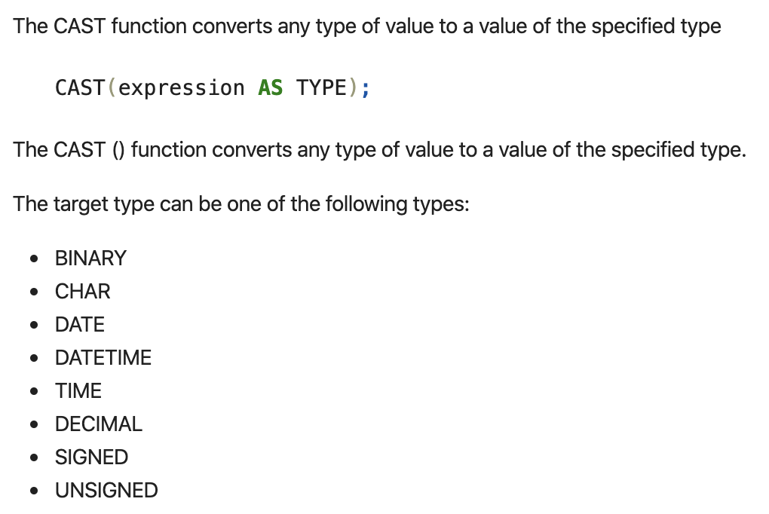
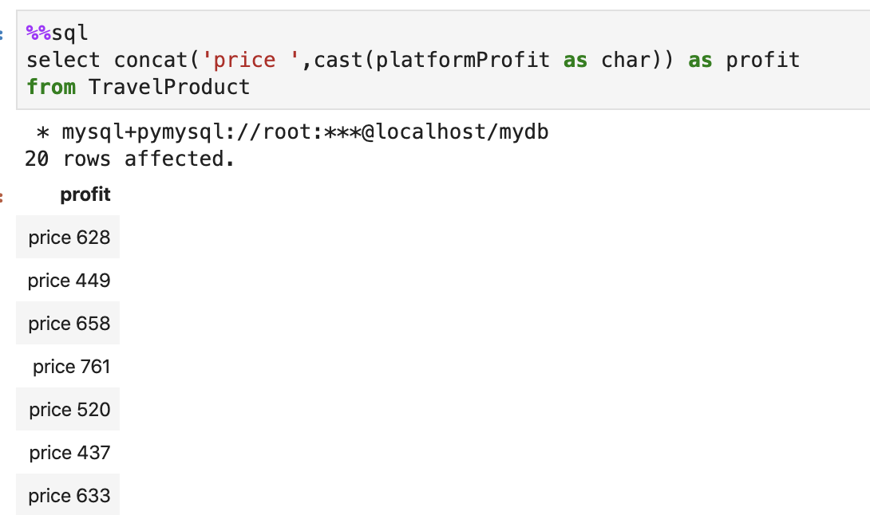
CAST

Slide 55

BINARY

Slide 56
Aggregate functions
Performs a calculation on multiple values

Slide 57

Aggregate functions

Slide 58

Other functions

Slide 59
Now let’s talk about join
Connect one table to different table

Slide 60


Cross join

Slide 61


Inner join

Slide 62


Left join

Slide 63


Right join

Slide 64
Query in query
Perform Queries and Sub-queries operations and display the result using SELECT statement

Slide 65

Sub-query

Slide 66


Sub-query

Slide 67
Privilege Management
Create four different users (Admin, Tester, Developer and User)

Slide 68

Grant

Slide 69

Grant

Slide 70

Revoke

Slide 71

Revoke

Slide 72
Perform more complex logic
STORED PROCEDURE

Slide 73

STORED PROCEDURE

Slide 74

STORED PROCEDURE

Slide 75
Something like git
Perform COMMIT and ROLLBACK operations with SAVEPOINT/ROLLBACK TO SAVEPOINT

Slide 76

Transaction

Slide 77

Lock

Slide 78


Lock

Slide 79
Do something after insert
Perform Triggers operations using INSERT, UPDATE, DELETE

Slide 80

Trigger

Slide 81


Trigger

Slide 82
Hide complex
Perform three examples of VIEW operation simple, and with increasing Complexities

Slide 83

View 1 & 2

Slide 84

View 3

Slide 85

Thanks!
Zixiao

